Slide 1
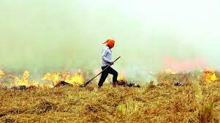
Stubble Aggregation and Disposal
-SELL YOUR STUBBLE
Team 12
B .Sathvika-100
V.Akshitha-307
B.Rithika-088

Slide 2
ABSTRACT
Stubble management is a web development project that helps farmers to sell their stubble and earn money. While most of the AgriTech start-ups are focused either on supply chain, focus is now expanding to farm and yield management. The area that still remains un-explored is the “stubble left after grain segregation”. As many of us think that stubble which occurs after grain segregation is not useful. So, in order to dispose the waste people usually burn stubble. But stubble burning is very dangerous as it releases lot of harmful gases which effects environment by causing pollution. Stubble burning is an alarming issue today in North India. To overcome that situation we came with an idea of automating the process of stubble collection and reuse of the stubble. For example the stubble that come from rice grain is rich in fibre . So by mixing a chemical with that stubble we can produce an item which is rich in fibre . In our project farmers gain a lot of help, by collecting all types of stubble. We then display of list of industries who are ready to buy the stubble. The people who are selling can select an industry based on their payment, rating. By doing this, we can save the environment from pollution and also the pay of farmers increases . As we are reproducing some waste, to do that we need people which indirectly increases the jobs for people.
Stubble management is designed to make your cropping cycle more efficient and less costly . The benefits of this project are reducing harvest cost , reducing fuel consumption , eco-friendly environment.

Slide 3


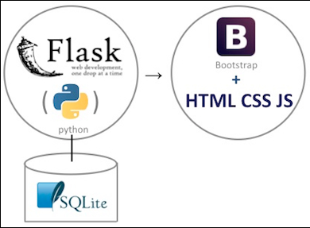

ARCHITECTURE

Slide 4

SOFTWARE REQUIREMENTS
Operating System : Windows 7 or more
Front End :HTML ,CSS ,Java Script
Back End : Python Flask
Smart Phone/Personal Computer
Browser(Recommended : Goggle Chrome/MS Edge)
Good Internet Connectivity

Slide 5
REFERNCES
https://www.bbc.com/news/world-asia-india-54930380
https://www.youtube.com/results?search_query=navin+reddy+django
https://www.youtube.com/results?search_query=aman+dhattarwal+web+development
https://www.sih.gov.in/sih2020PS

Slide 6
THANK YOU

